Slide 1

Complex Data Using ASF
Indian Institute Of Technology, Bombay
For Prayagraj (B)
Student Name: Riya Sunil Kharade
Guided BY : Prof. Gulab Singh
Subject : Microwave Satellite Data Processing

Slide 2
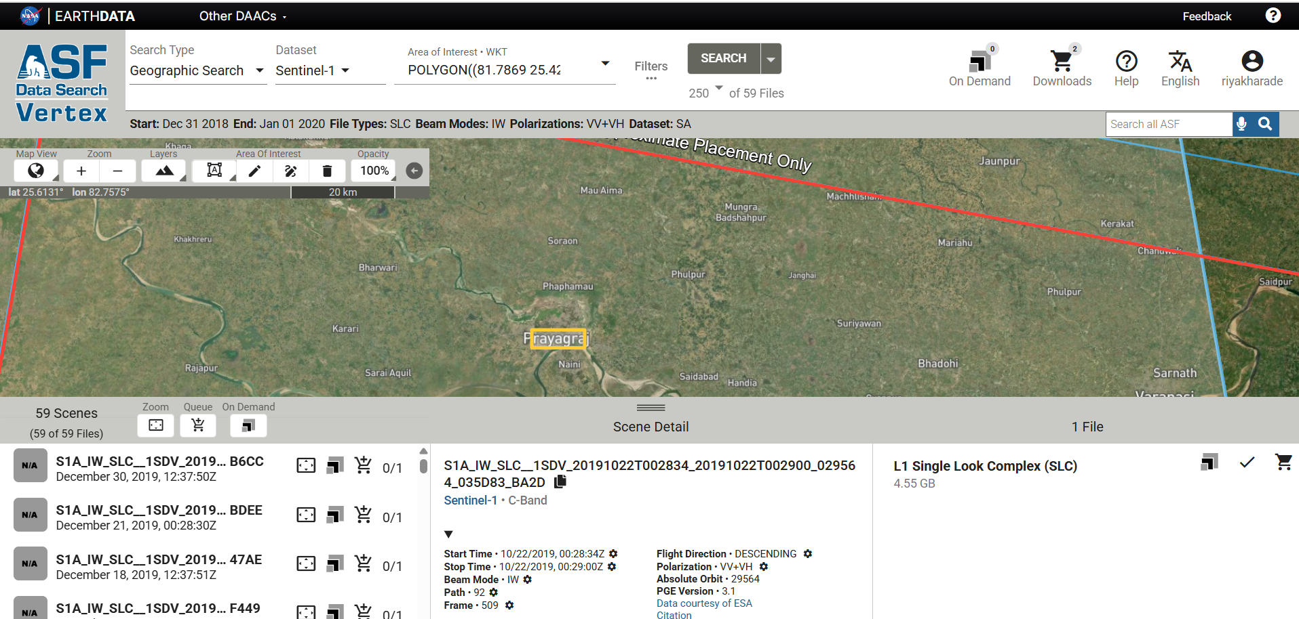
Data Downloading Using ASF for Prayagraj

Slide 3
Import S1 A Data /S1 Tops- Split
Drag and Drop folder

Slide 4
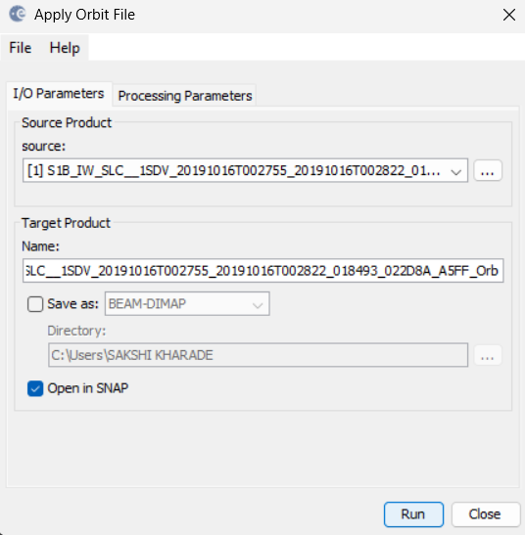
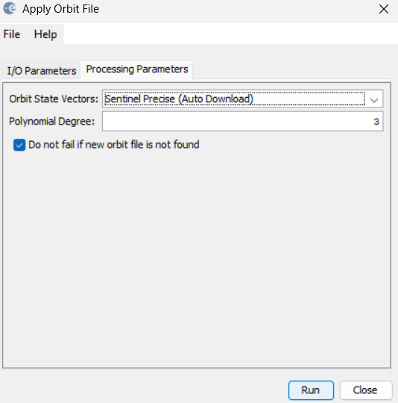
Step 1: Apply Arbit File
Radar-Apply Arbit File-Run

Slide 5
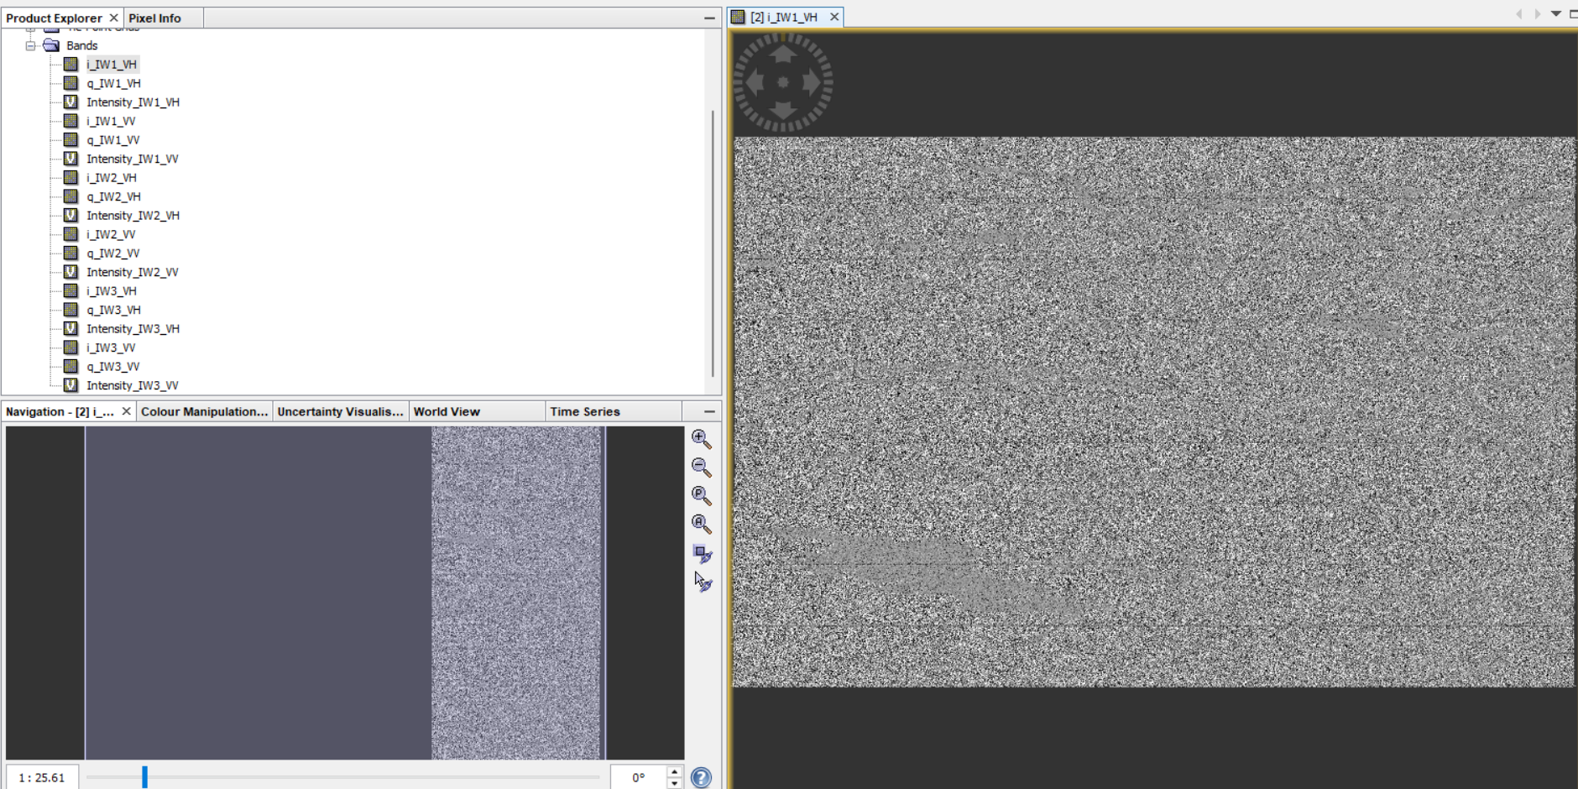
OUTPUT

Slide 6
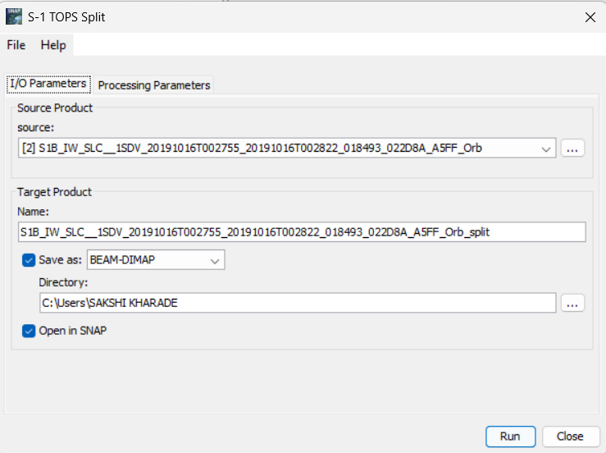
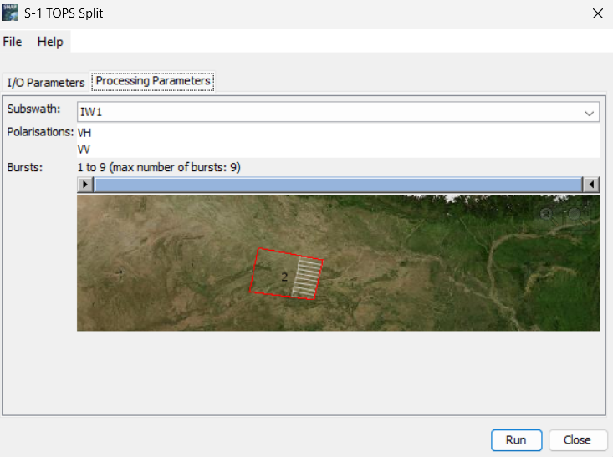
Step 2: Split
Radar-Sentinel 1 TOPS – S1 TOPS Split

Slide 7
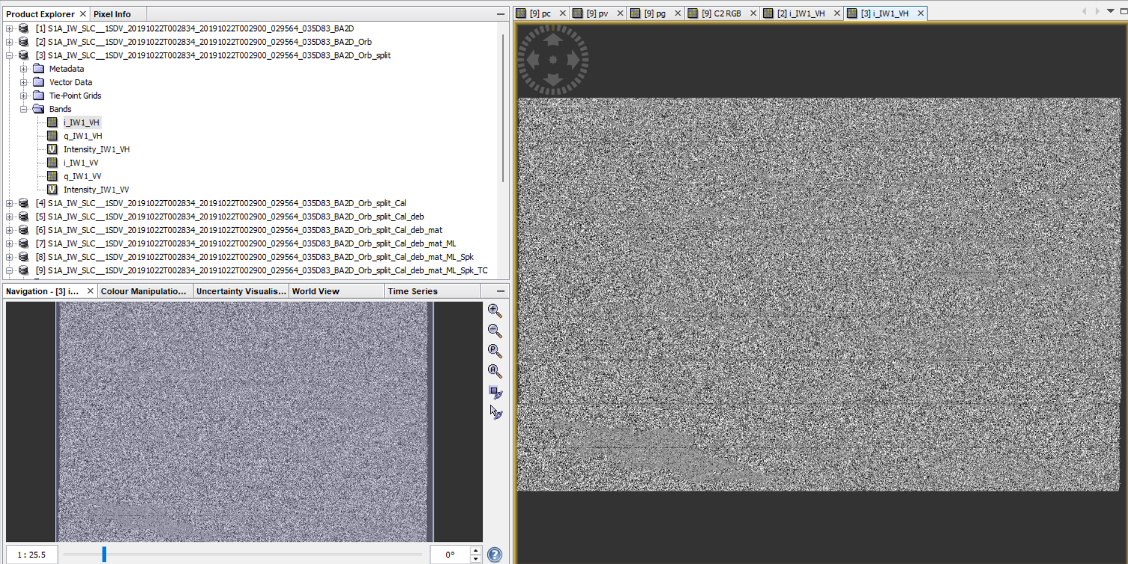
OUTPUT

Slide 8
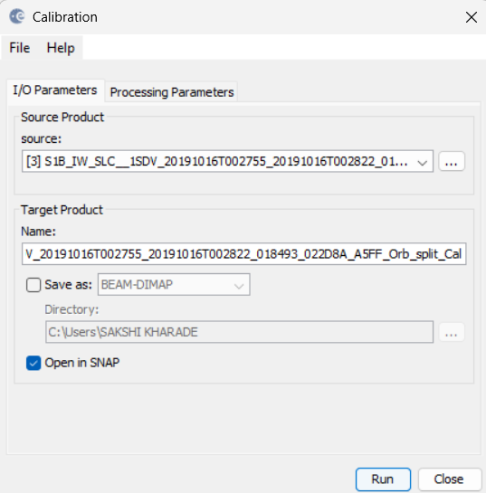
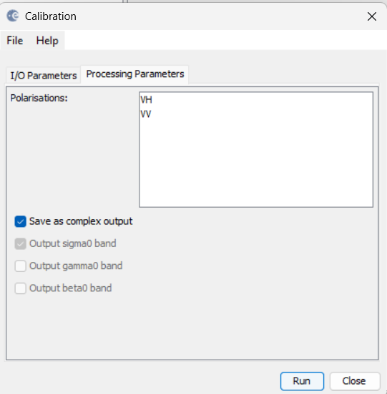
Step 3: Calibration
Radar-Radiometric-Calibration

Slide 9

OUTPUT

Slide 10
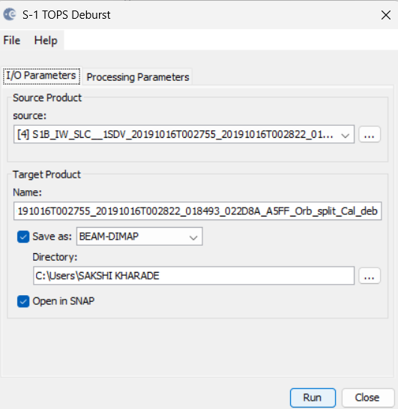
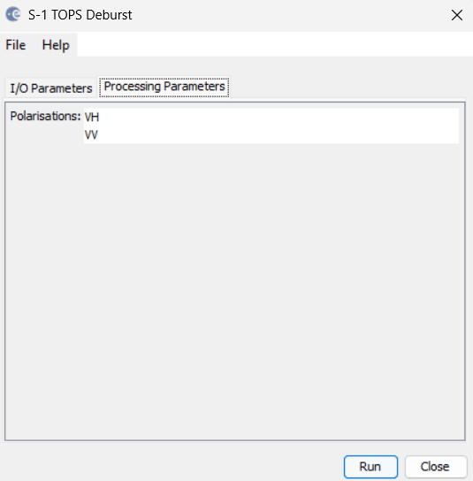
Step 4: Deburst
Radar-Sentinel 1 TOPS- S1 TOPS Deburst

Slide 11
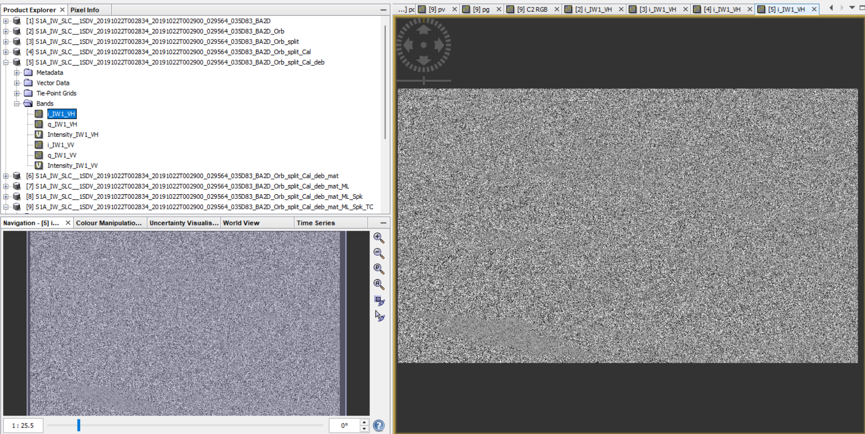
OUTPUT

Slide 12
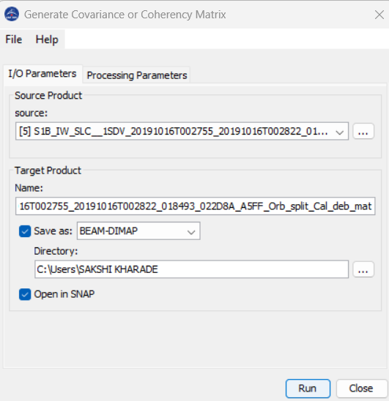

Step 5: Matrix
Radar-Polarimetric-Polarimetric Matrix Generation

Slide 13
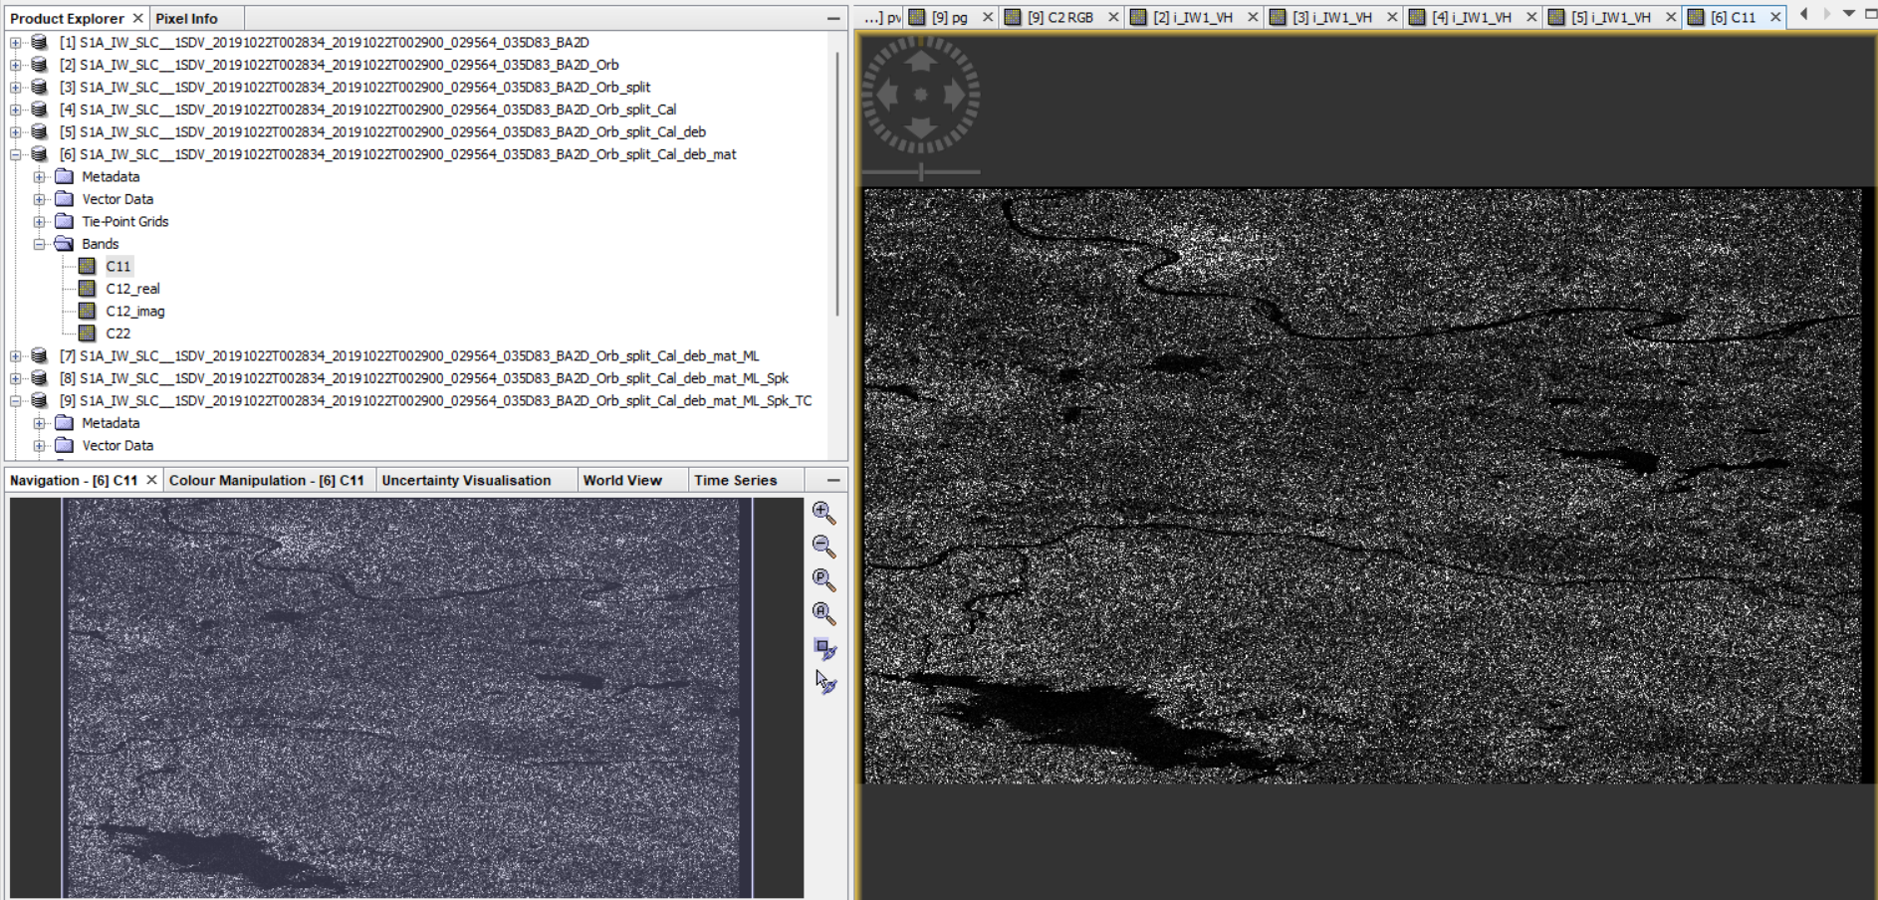
OUTPUT

Slide 14
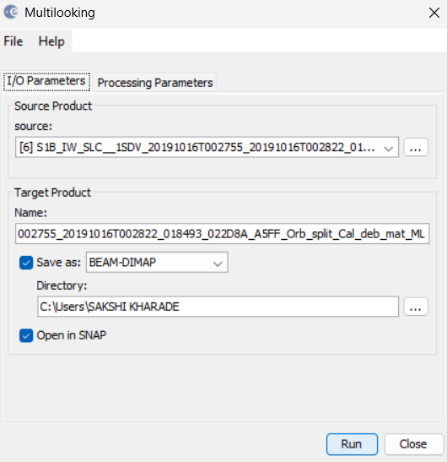
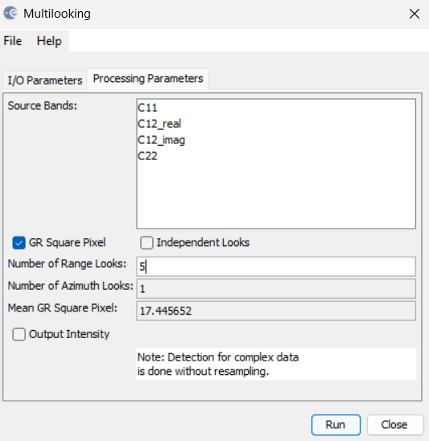
Step 6: Multilooking
Radar-SAR Utilities-Multilooking

Slide 15
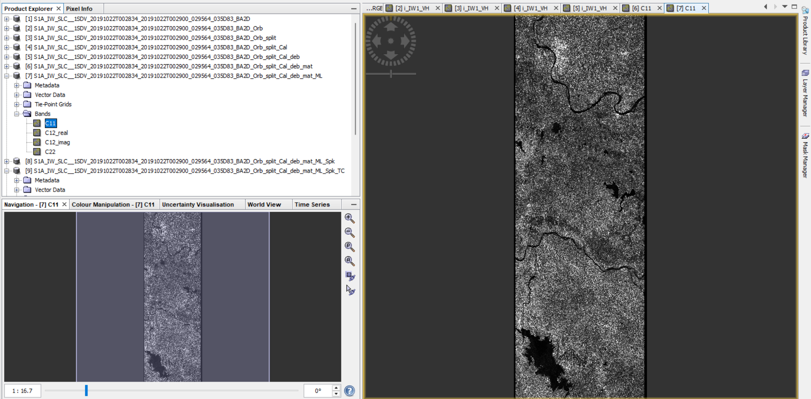
OUTPUT

Slide 16
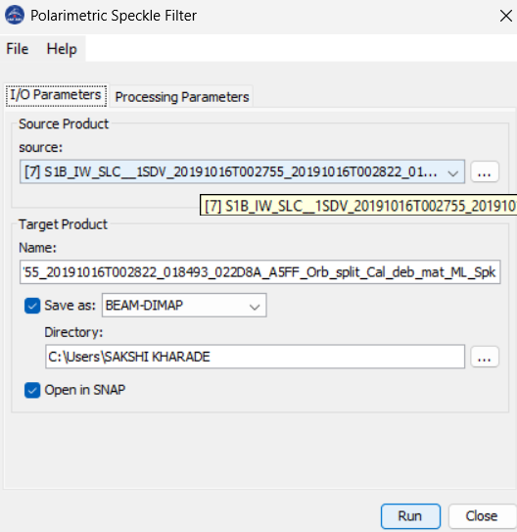
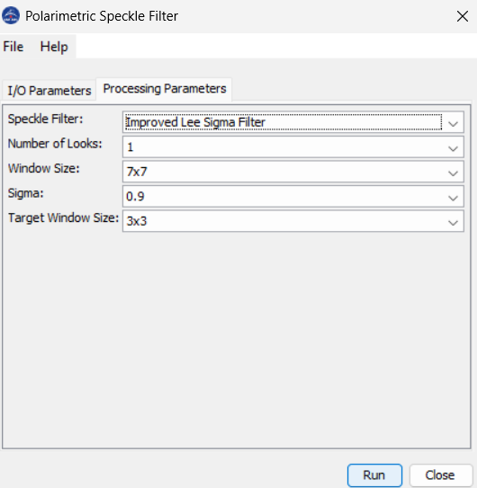
Step 7: Speckle Filtering
Radar-Polarimetric-Polarimetric Speckle Filter

Slide 17
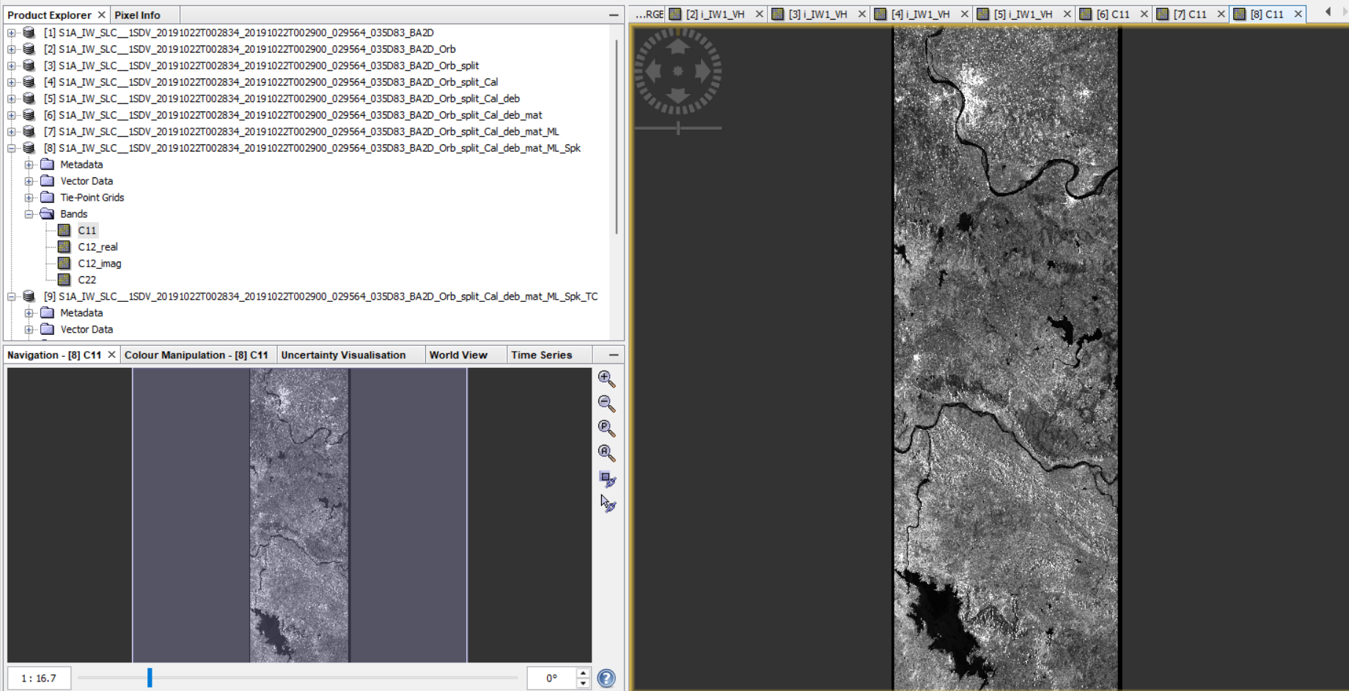
OUTPUT

Slide 18
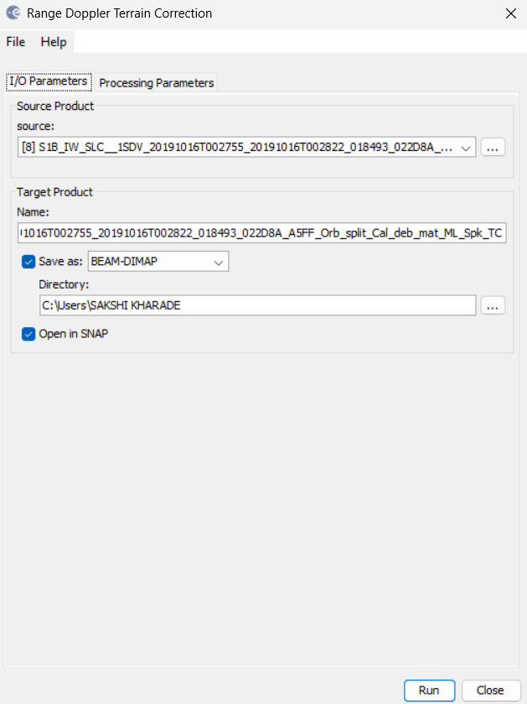
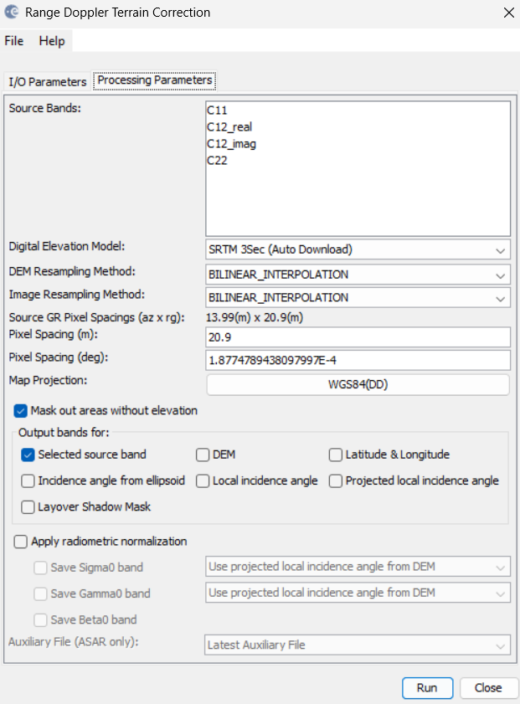
Step 7:Range-Doppler Terrain Correction
Radar-Geometric-Terrain Correction-Range Doppler Terrain Correction

Slide 19
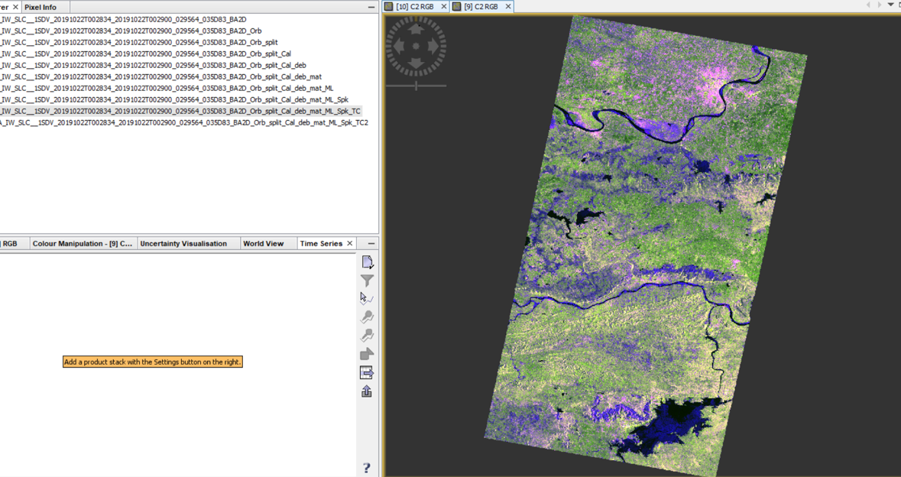
OUTPUT

Slide 20
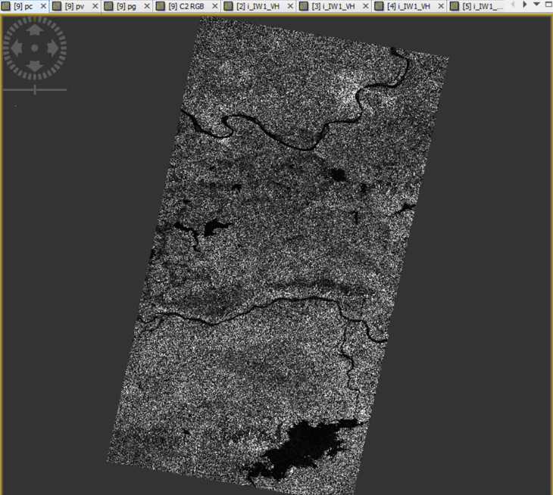
Step 8: Calculate PC,PV,PG
Use Build Maths
PC=FC=2 |IMG (C12)|
PV=FV=2(2*C22-PC)
PG=FG=C11-3/4*PV-PC/2
PC for RED
PV for Green
PG for Blue

Slide 21
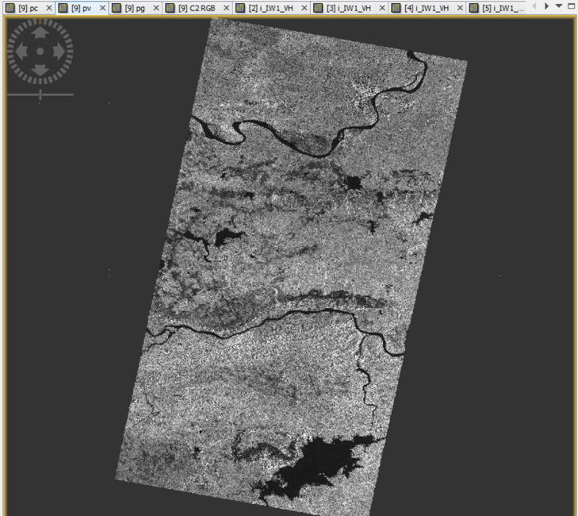
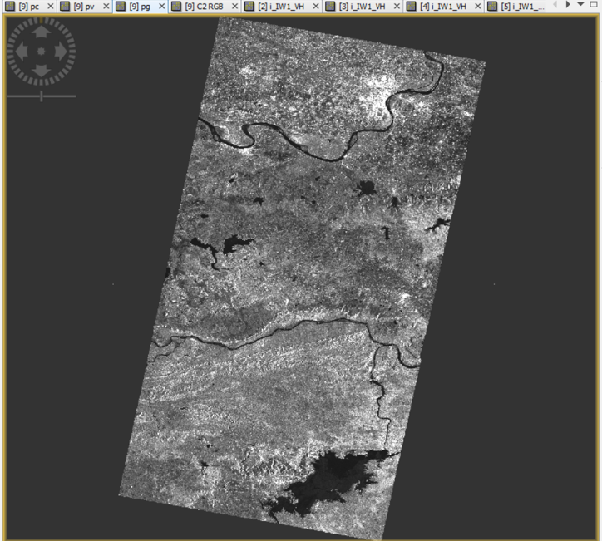
OUTPUT

Slide 22
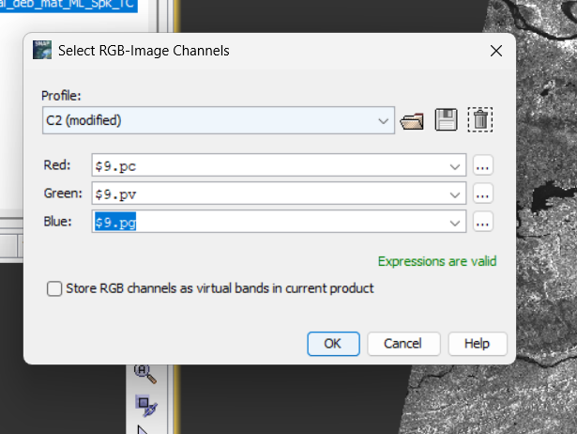
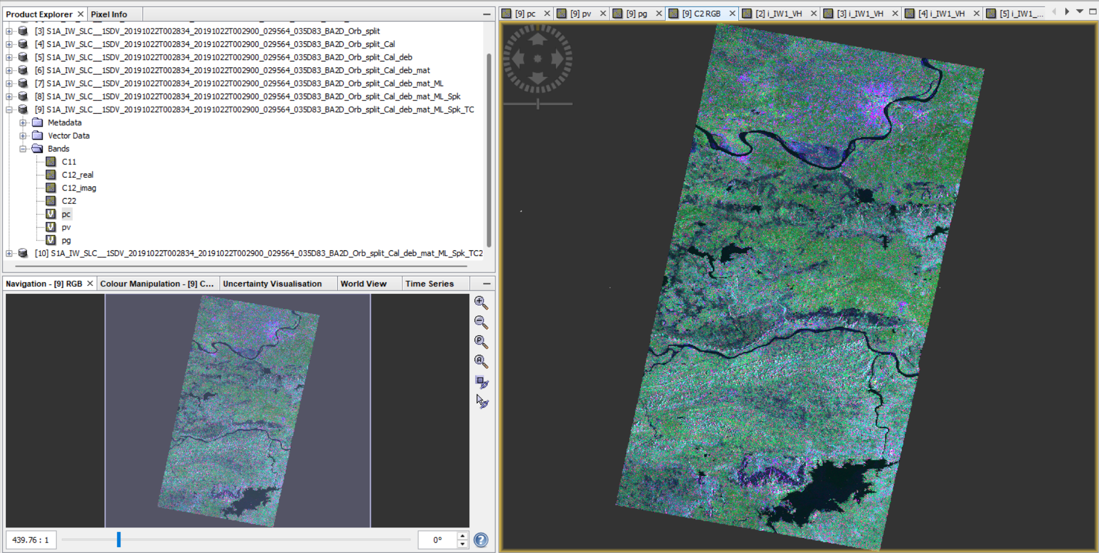
Step 9: RGB Image Window
Right Click On TC file-Open RGB Image Window

Slide 23
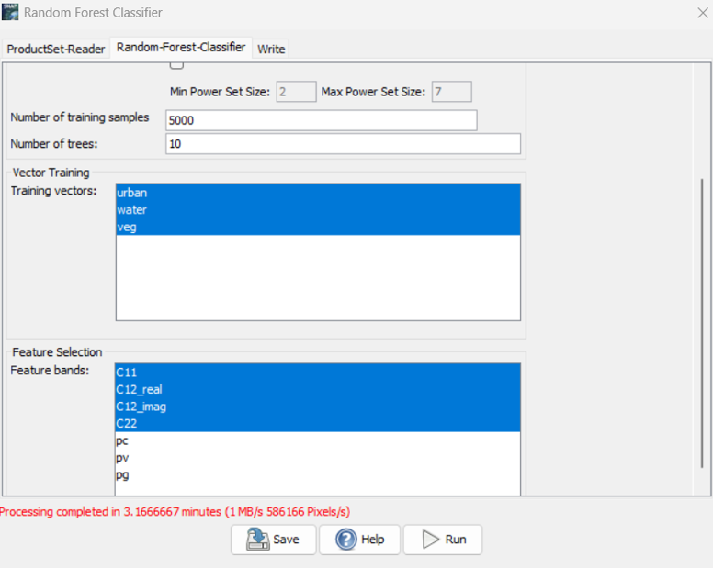
Step 10: Classification (Supervised)
Vector-New Vector Data Container
Raster-Classification-Supervised-Random Forest

